Slide 1
Overview of Other ML Techniques
Geoff Hulten

Slide 2
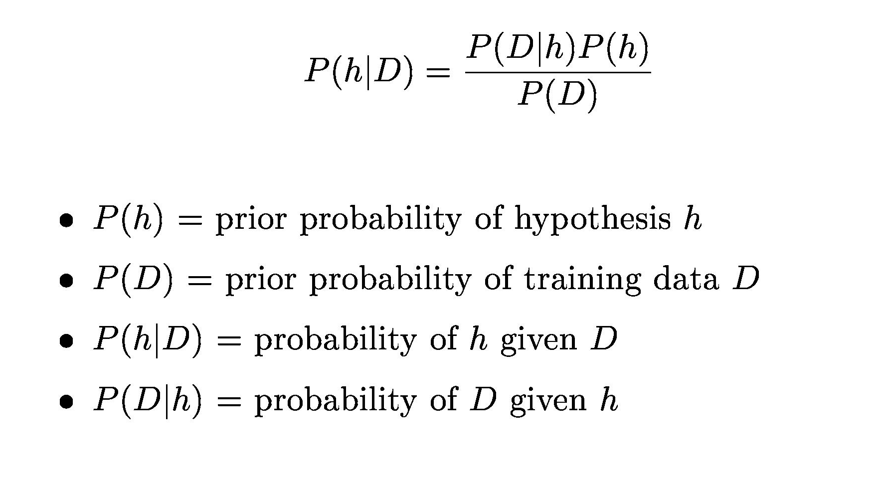
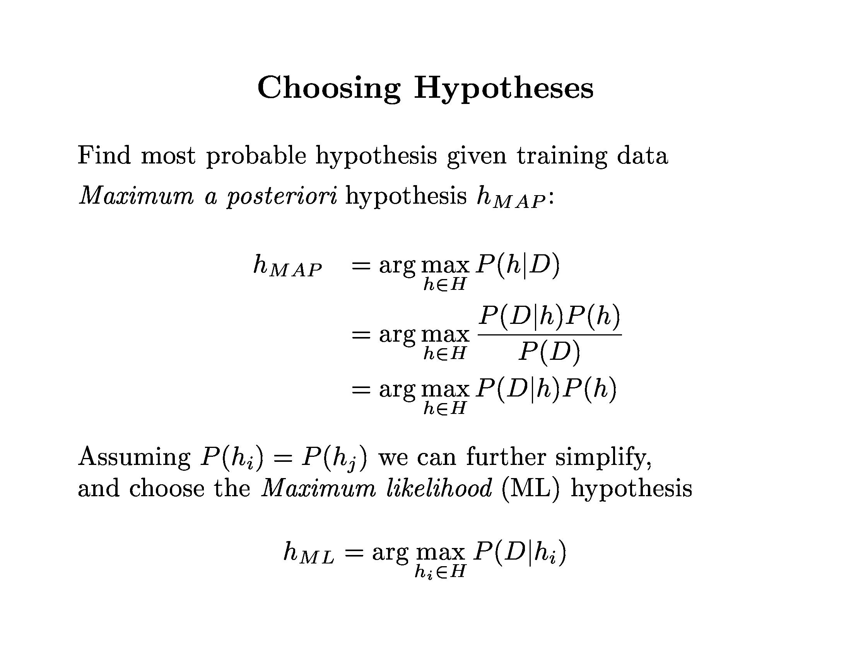
On Being Bayesian

Slide 3
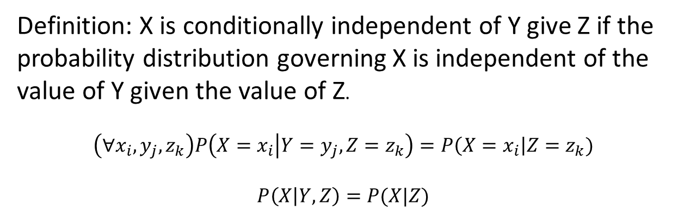
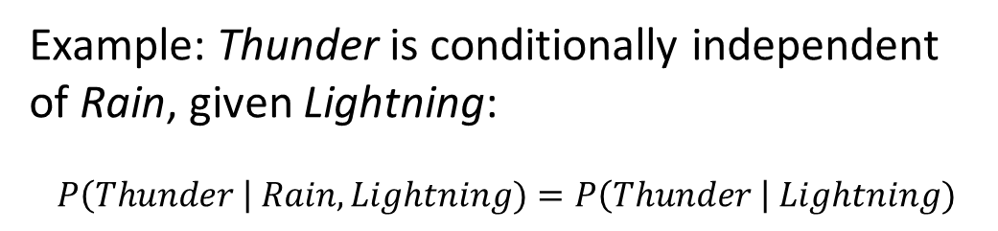
Conditional Independence
Definition: X is conditionally independent of Y give Z if the probability distribution governing X is independent of the value of Y given the value of Z.
$$\left(∀x_{i},y_{j},z_{k}\right)P\left(X=x_{i} | Y=y_{j}, Z=z_{k}\right)=P\left(X=x_{i}\right|Z=z_{k})$$
$$P\left(X | Y,Z\right)=P(X|Z)$$
Example: Thunder is conditionally independent of Rain, given Lightning:
$$P\left(Thunder \right| Rain, Lightning)=P\left(Thunder \right| Lightning)$$

Slide 4
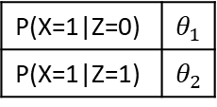



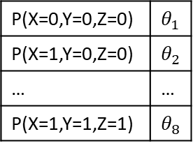

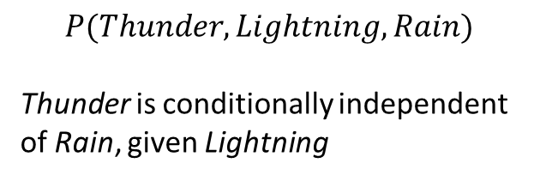

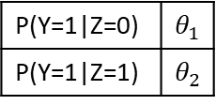
Bayesian Network
Represent conditional dependencies via a directed acyclic graph, where:
A variable is independent of its non-descendants given the value of its parents.
3 binary variables
P(X=0,Y=0,Z=0) | $θ_{1}$
P(X=1,Y=0,Z=0) | $θ_{2}$
… | …
P(X=1,Y=1,Z=1) | $θ_{8}$
$$P\left(X,Y,Z\right)= …$$
$$P(Thunder, Lightning, Rain)$$
Thunder is conditionally independent of Rain, given Lightning
Z
Eight Parameters
X
Y
Five Parameters
Rain
Thunder
$$P\left(X | Y,Z\right)=P(X|Z)$$
P(Z=1) | $θ_{1}$
P(X=1|Z=0) | $θ_{1}$
P(X=1|Z=1) | $θ_{2}$
$$P\left(Y | X,Z\right)=P(Y|Z)$$
Lightning
P(Y=1|Z=0) | $θ_{1}$
P(Y=1|Z=1) | $θ_{2}$
$$P\left(X,Y,Z\right)=P\left(Z\right)∗P\left(X | Z\right)∗P(Y|Z)$$
Decompose joint distribution according to structure

Slide 5




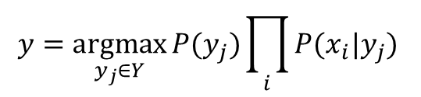


Inference in Bayesian Networks
$$y=\underset{y_{j}∈Y}{argmax}{P(y_{j})\prod_{i}{P(x_{i}|y_{j})} }$$
P(Rain) | .3
Rain
$$y$$
Lightning
P(Lightning|Rain=0) | .1
P(Lightning|Rain=1) | .5
$$x_{1}$$
$$x_{…}$$
$$x_{n}$$
Naïve Bayes
Super simple case
< Rain=0, Lightning=? >
$\sim$ P(Lightning|Rain=0)
= .1
< Rain=?, Lightning=1 >
$\sim$ P(Rain |Lightning=1)
$$→P\left(Rain=1\right)= \frac{P(Rain=1)P(Lightning=1|Rain=1)}{\sum_{i∈Rain}{P(Rain=i)P(Lightning=1|Rain=i)}}$$
Sorta simple case
In general use techniques like EM or Gibbs sampling

Slide 6
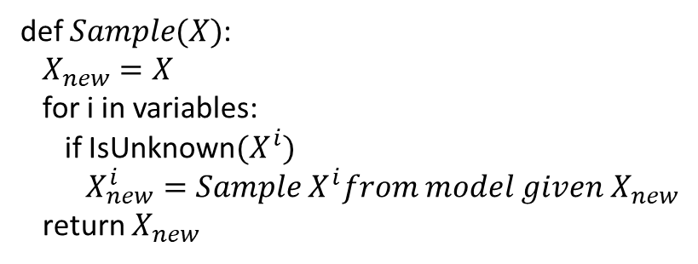
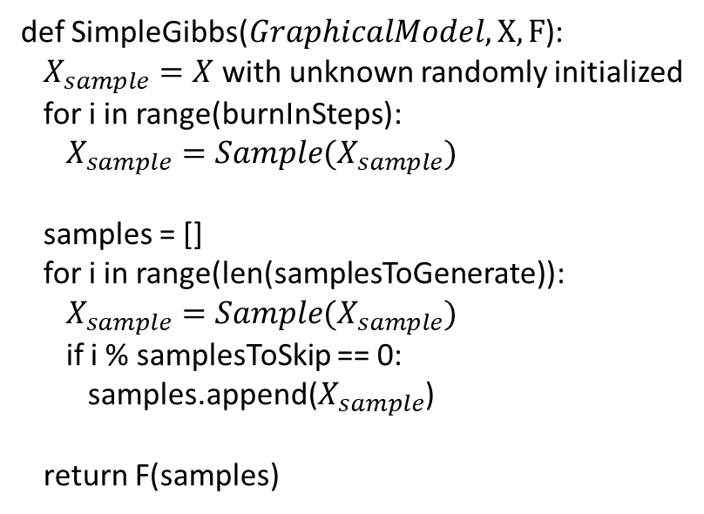
More Complex Inference Situation
def SimpleGibbs($GraphicalModel, X, F$):
$X_{sample}=X$ with unknown randomly initialized
for i in range(burnInSteps):
$X_{sample}=Sample(X_{sample})$
samples = []
for i in range(len(samplesToGenerate)):
$X_{sample}=Sample(X_{sample})$
if i % samplesToSkip == 0:
samples.append($X_{sample}$)
return F(samples)
Rain
TourGroup
Lightning
Campfire
Thunder
ForestFire
$P\left(Rain \right|ForestFire=1, Thunder=0)= ??$
def $Sample(X)$:
$X_{new}=X$
for i in variables:
if IsUnknown${(X}^{i})$
$X_{new}^{i}=Sample X^{i}from model given X_{new}$
return $X_{new}$

Slide 7
Learning Bayesian Networks
Just a Joke:
Combine EM with
structure search…
Search for structure:
Initial State: empty network or prior network
Operations: Add arc, delete arc, reverse arc
Evaluations: LL(D|G) * prior(G)
Structure
Unknown
Abandon Hope
Structure
Known
MAP Estimates for Parameters
(Like Naïve Bayes)
EM Algorithm
All Variables Observed
Some Variables Hidden

Slide 8
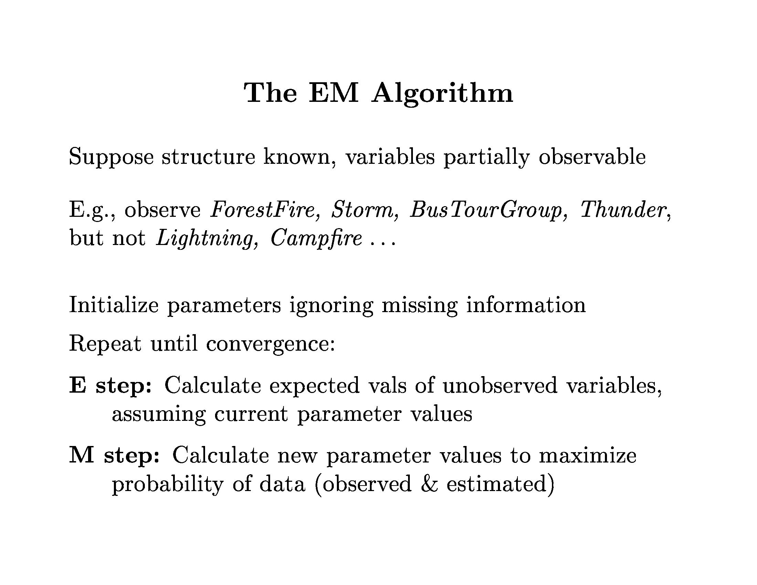

Slide 9
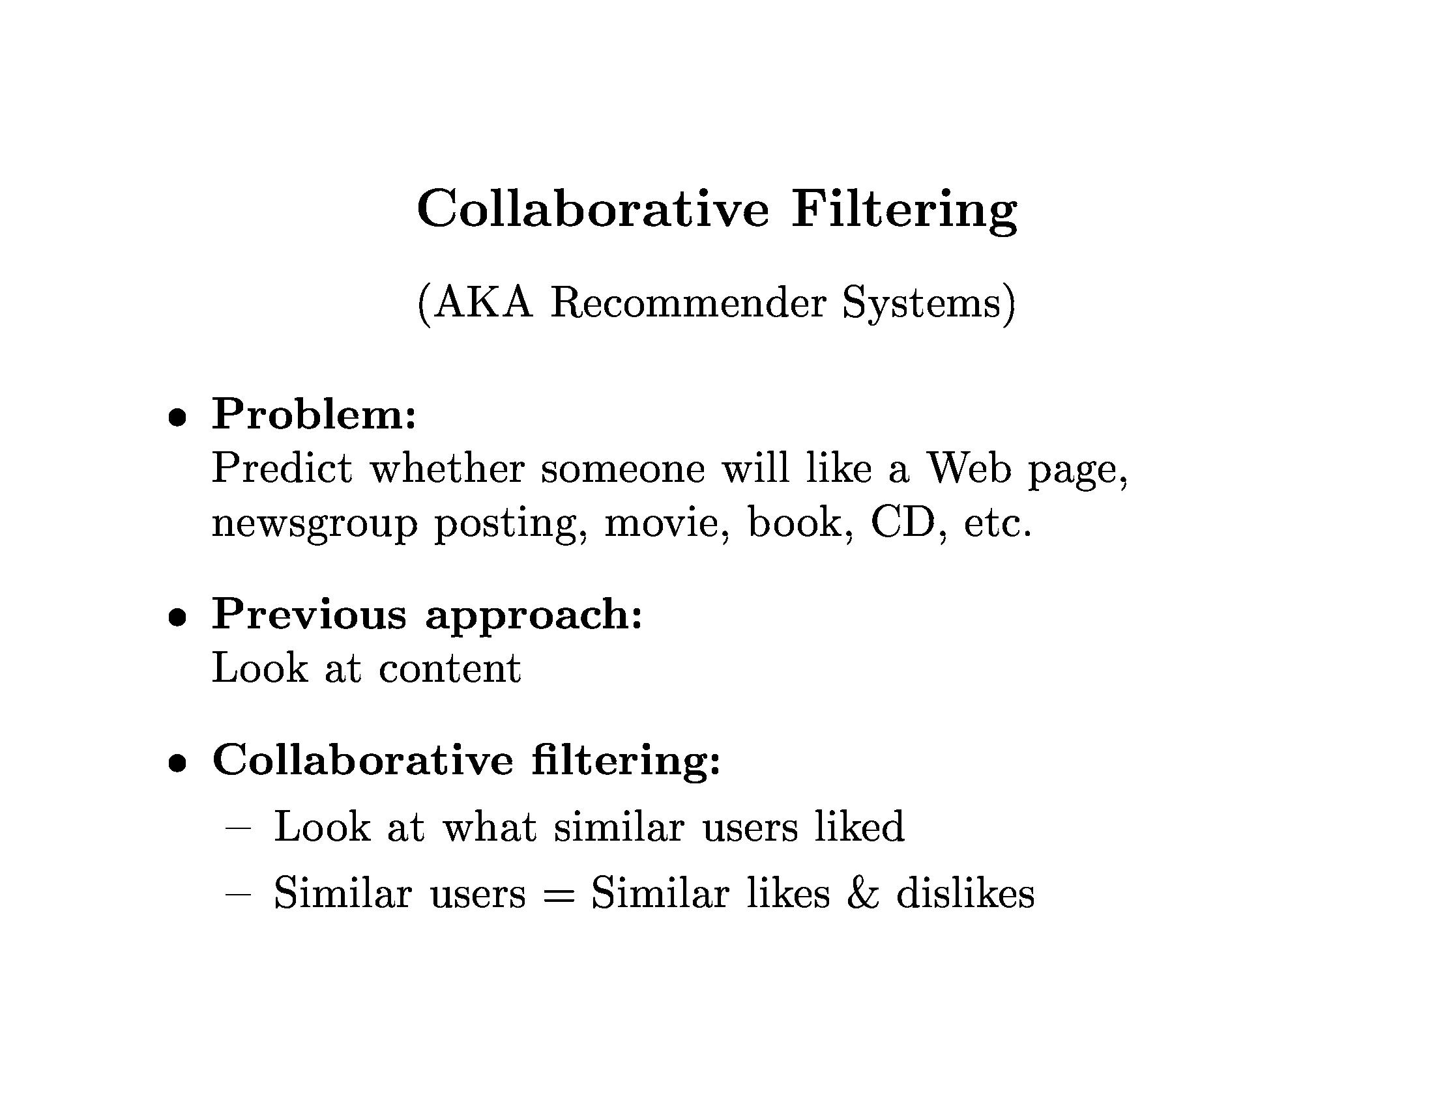

Slide 10
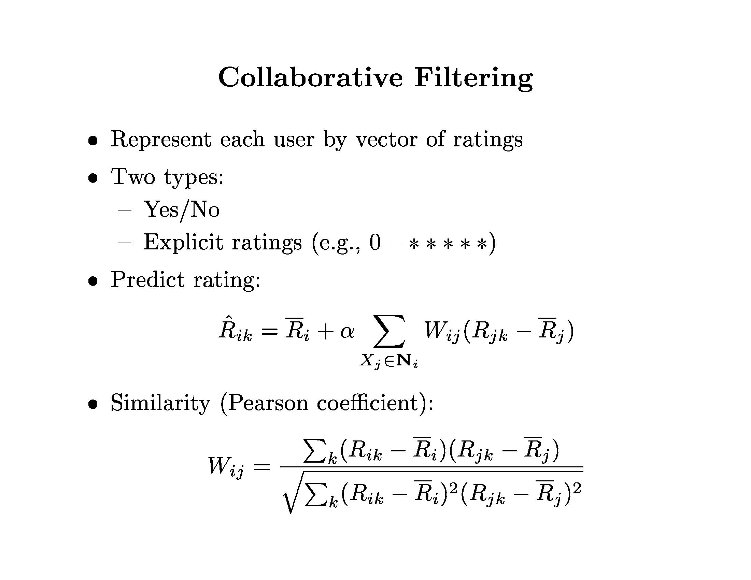
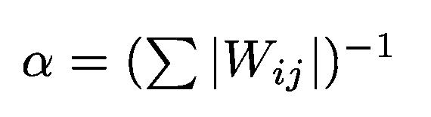
Normalization

Slide 11
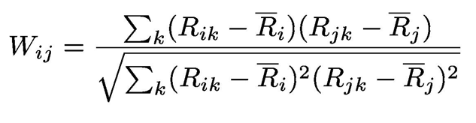

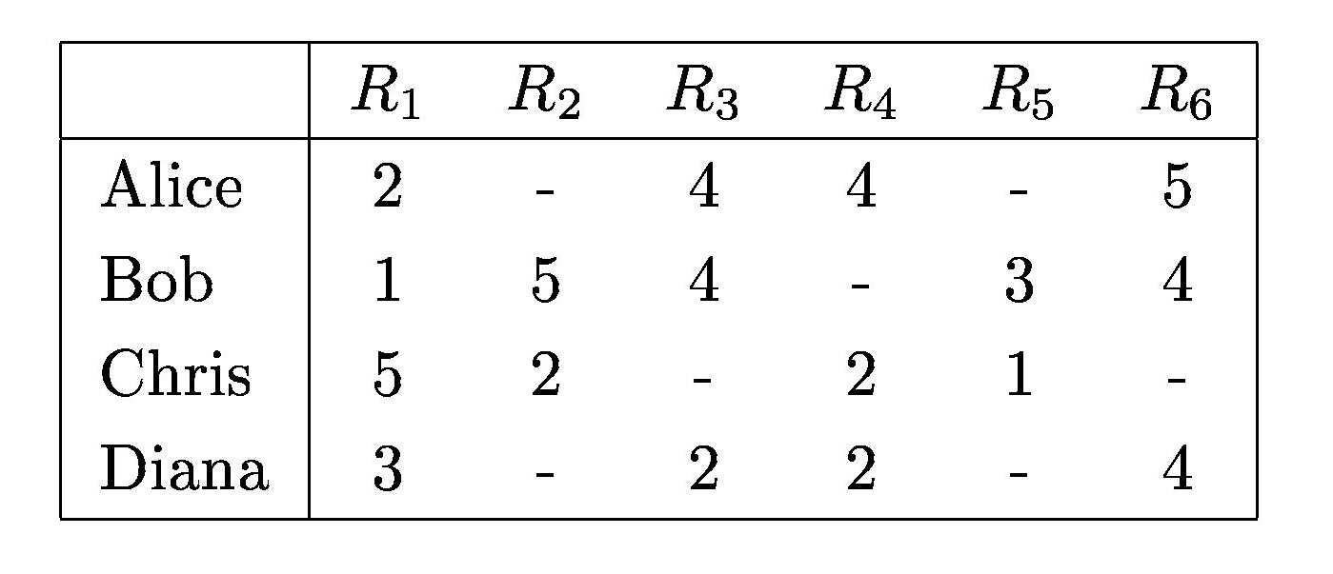
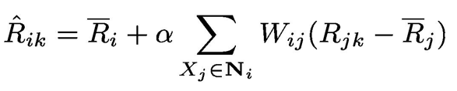







Example of Collaborative Filtering
Will Alice like ${Movie}_{2}$?
$$W_{Alice,Bob} = 1.38$$
$$W_{Alice,Chris} =−1.41$$
$$α=.357$$
$${\hat{R}}_{Alice,2}=3.75+.357(1.38\left(5−3.4\right) −1.41\left(2−2.5\right))$$
$${\hat{R}}_{Alice,2}=3.75+.357(2.22+0.70)$$
Challenges:
Cold Start
Sparsity
$${\hat{R}}_{Alice,2}=3.75+1.04$$
$${\hat{R}}_{Alice,2}=4.79$$

Slide 12
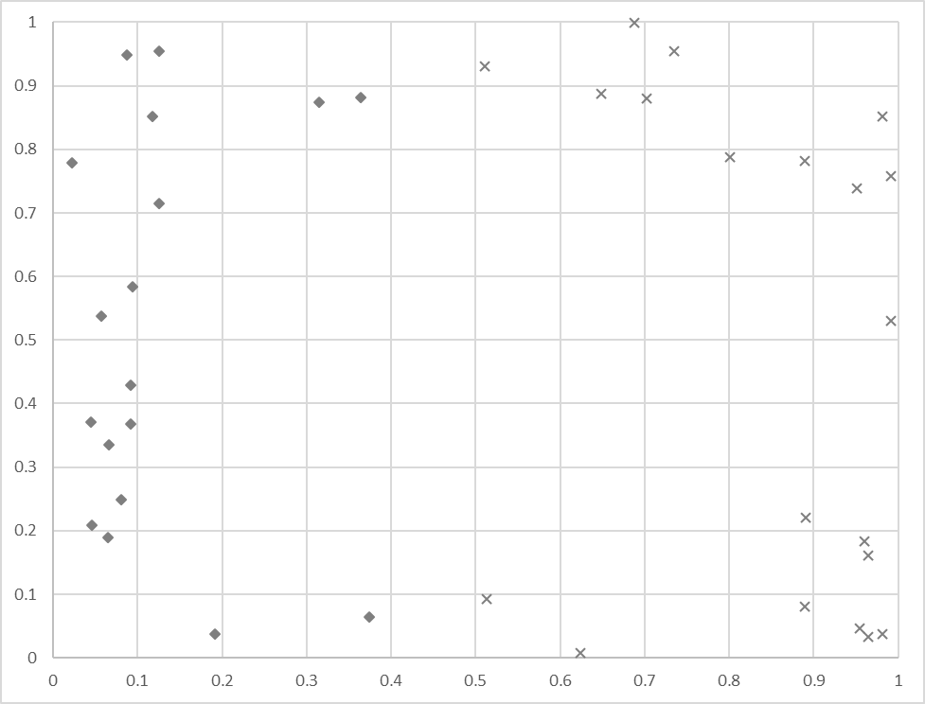
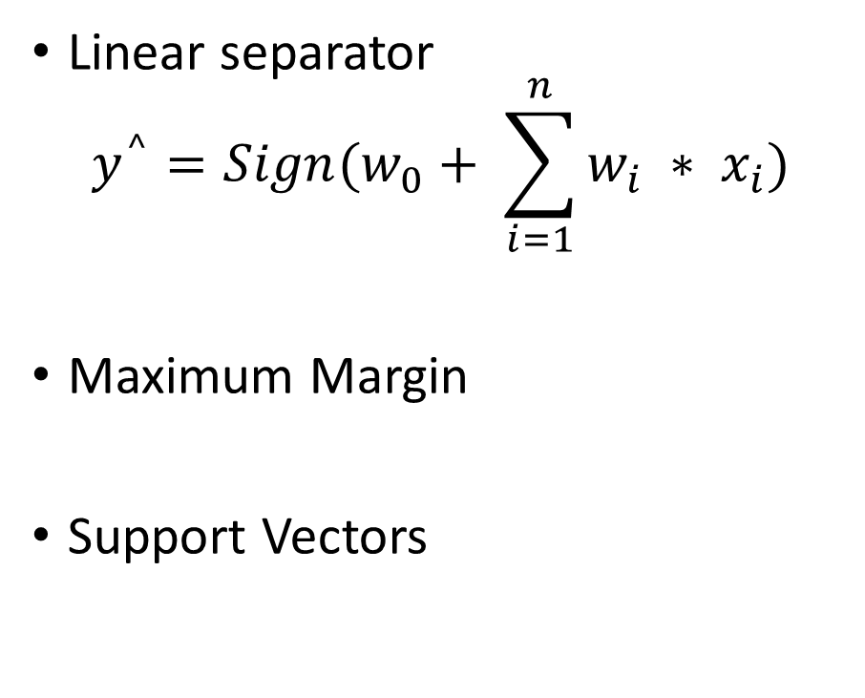
Support Vector Machine (SVM)
Linear separator
$$y^{^}=Sign(w_{0}+ \sum_{i=1}^{n}{w_{i} ∗ x_{i})}$$
Maximum Margin
Support Vectors

Slide 13
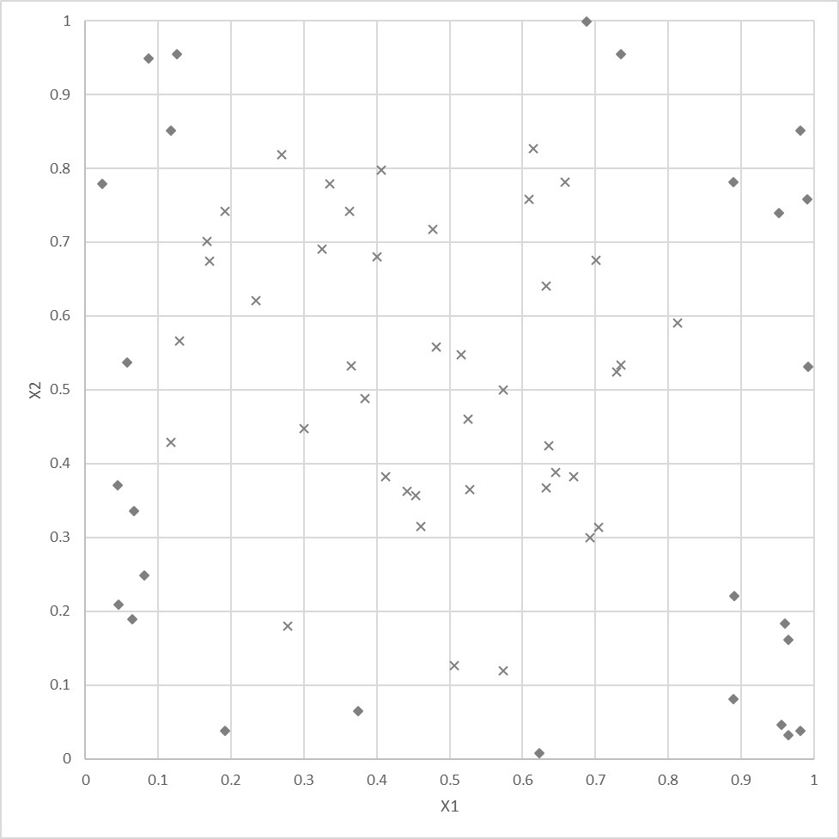
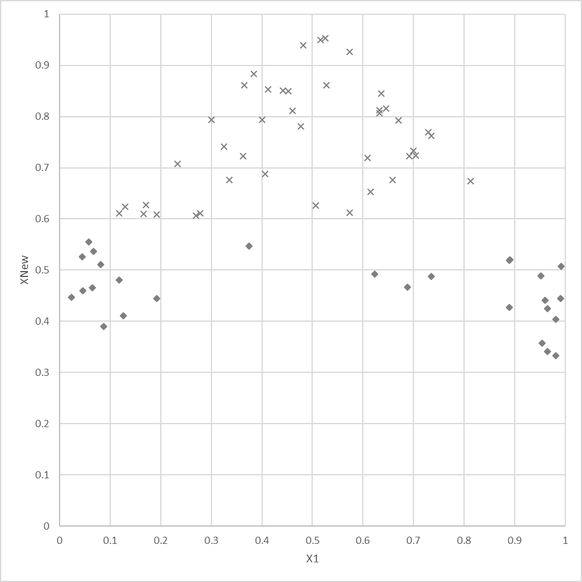
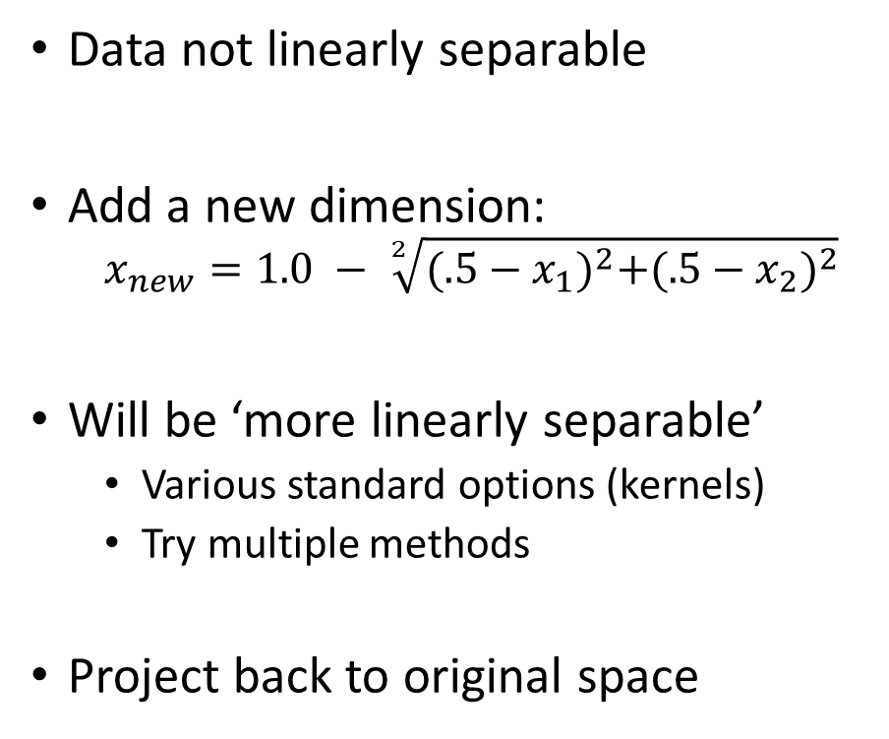
Support Vector Machines
For non-linear data
Data not linearly separable
Add a new dimension:
  $$x_{new}=1.0 − \sqrt[2]{{(.5−x_{1})}^{2}+{(.5−x_{2})}^{2}}$$
Will be ‘more linearly separable’
  Various standard options (kernels)
  Try multiple methods
Project back to original space

Slide 14
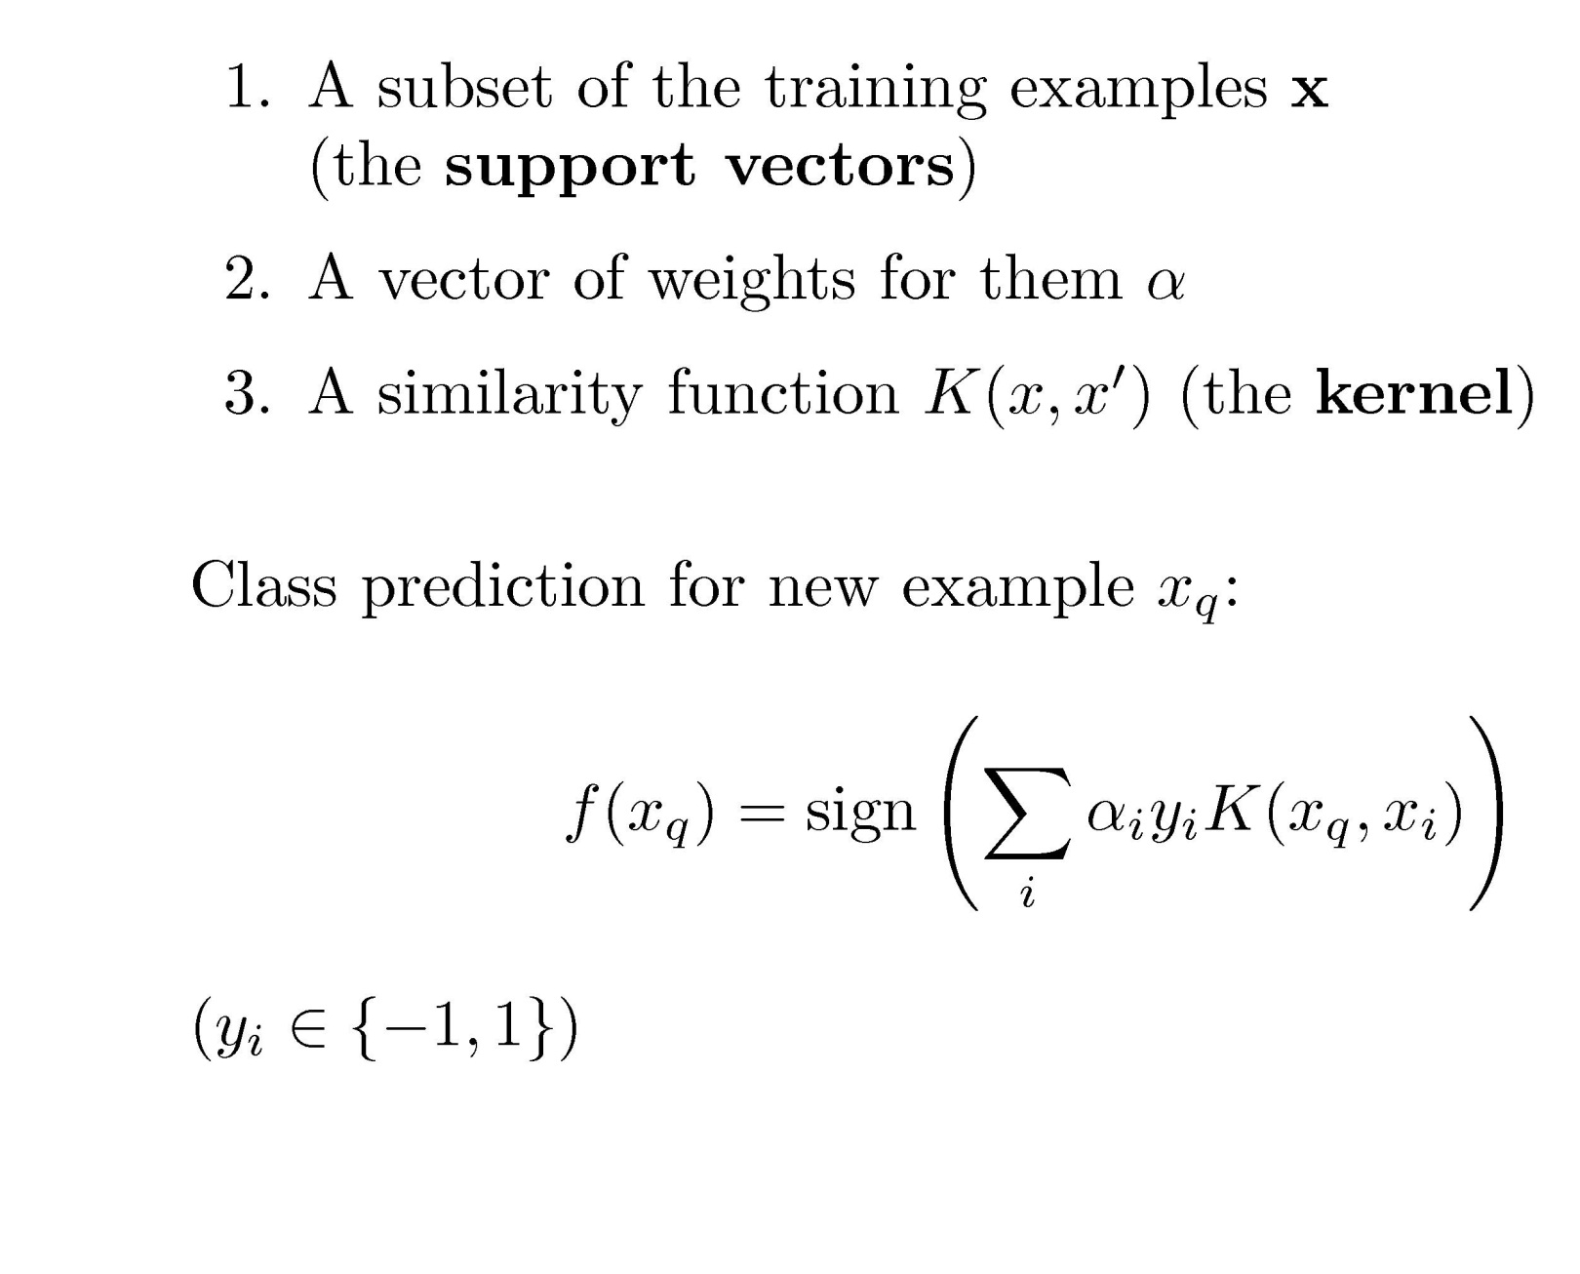
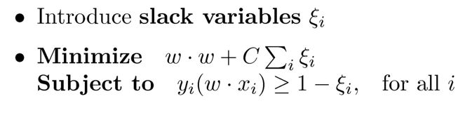
Support Vector Machines (More Concepts)
Optimization
  Solve constrained system of equations
  Quadratic programming (e.g. SMO)
Dealing with noise (soft vs hard)

Slide 15
Summary
There are a lot of Machine Learning Algorithms…

